Slide 1

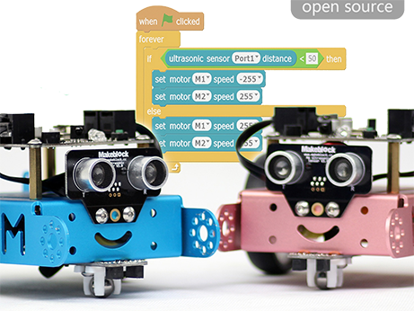
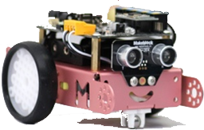
A mbot Workshop
For Kids
By Simon Rininsland und Stefan Höhn
Note: Not all graphics are yet in english but you
probably get along fine. We hope to have updated
the slides soon completely.

Slide 2
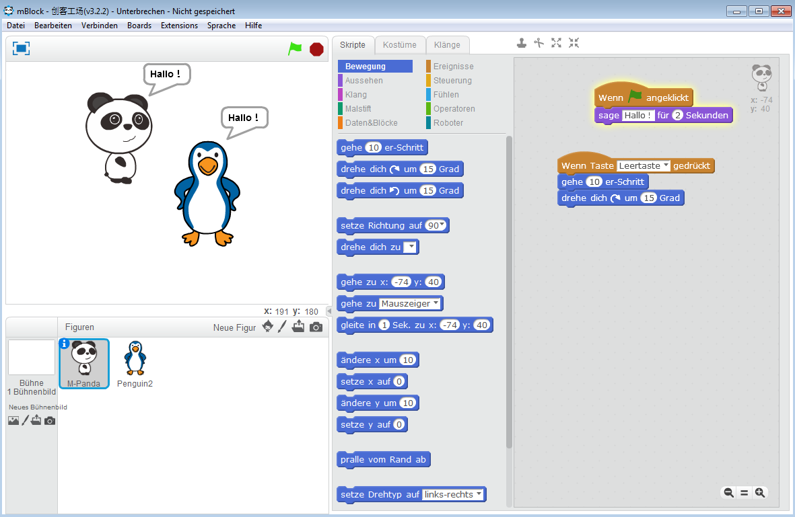

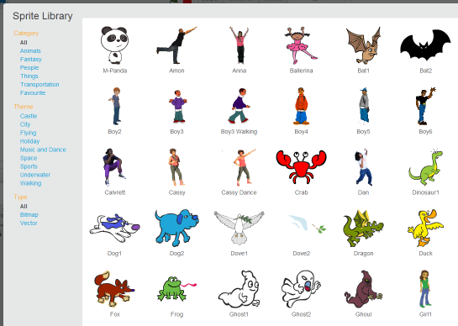
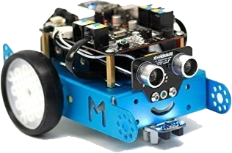
What is where?
stage
Stage
Component area
Chose a character

Slide 3
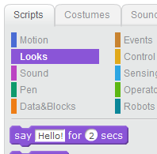




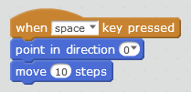

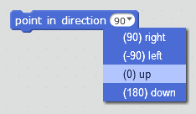
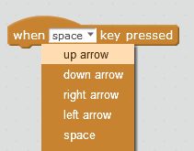
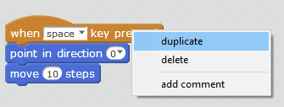

Say Hello
and
Good Morning I am the dino! … for 5 seconds
I learn to walk…
and
Tip: Duplicate blocks
With right-click
Add a „when key“ with „down“ and direction down
Use 20 instead of 10
Try all directions

Slide 4
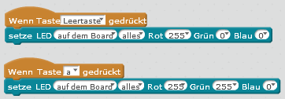
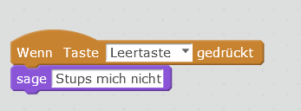

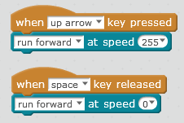
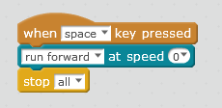
Mbot beeps and blinks
Control light
and
Switch off the light with a different key
Make music and use the light – like in a disco.
mBot learns to walk
Emergency button!
and
Try all directions and different speeds

Slide 5
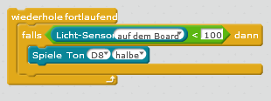

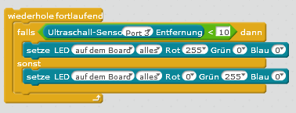

mbot is scared in the dark
mbot shouts when dark
The character tells different
Number when dark
Combine with movement and stop mbot in the darkness
Switch on light in the darkness
mbot can see!
und
Mbot turns red when you get too near…
Close mbots eyes…
Try different numbers and change light color

Slide 6
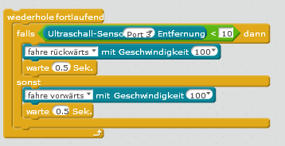
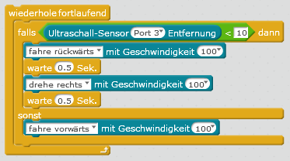
mbot dances
Lead mbot with your hand
Let mbot drive forward and back. Change the speed and add light to it.
Add a security behavior, so it does not drive into a wall.
mbot does what it wants…
und
Mbot searches its own way
If mbot notices the darkness let him start crying (=beeping)
If there is a blocking area let mbot drive into a different direction to find more space.
let mbot drive slowly if it gets dark

Slide 7
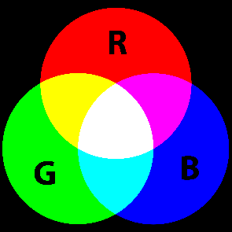
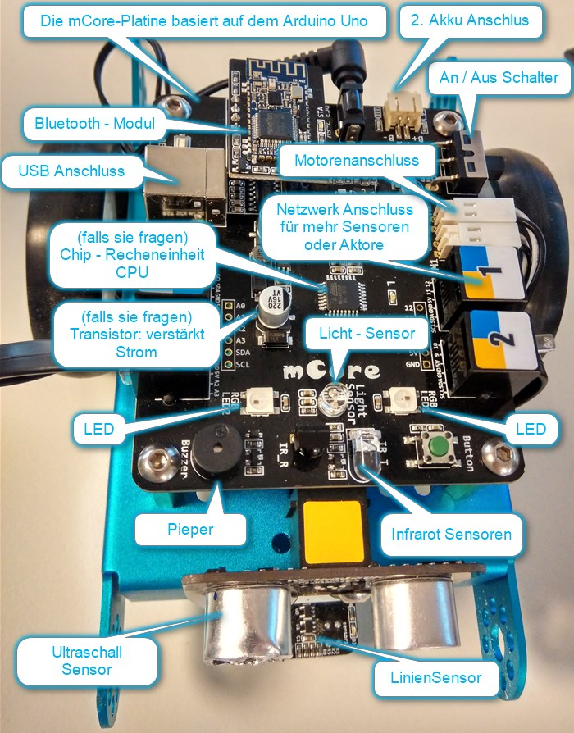
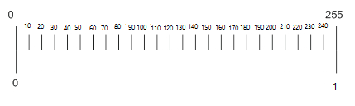
Mentor Cheat-Sheet
Describe the setup of the mblock program (slide 2a)
Show mbot and explain the sensors and actors
Explain roughly what to do
BOTH childredn should chose a charactor and program the same after each other until 3b and then alternately continue.
Beschreibe den Kids den Aufbau des Programms (Folie 2a)
4. Let the kids decide whether clean up after each step or not. However after some time it might too untidy.
Warning: Do not use the same key twice!
5. Use Emergency Button after each try as a kind of „reset“
Note: stop loops after every change by clicking on it.
Save frequently from begin on
RGB
red– green– blue
All colors are possible like in a tv screen if you look very closely.
scale 0 - 255

